Slide 1
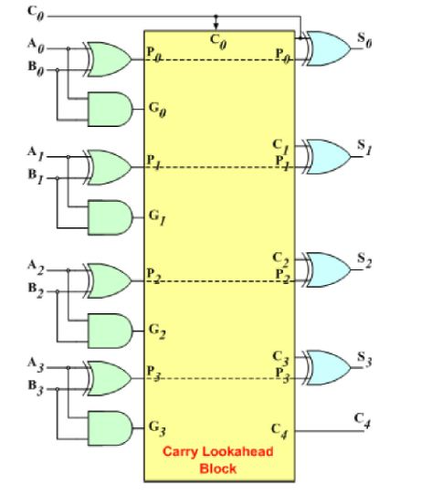
Demystifying Speed: Exploring the 4-Bit Carry Lookahead Adder
Introduction to advanced adder architectures for faster arithmetic operations
EEM410 - IC DESIGN
SAMET BAYAT - 22293730 RAMAZAN ALPER - 22098516
Nazım Görkem ALPYILDIZ (21793608)

Slide 2
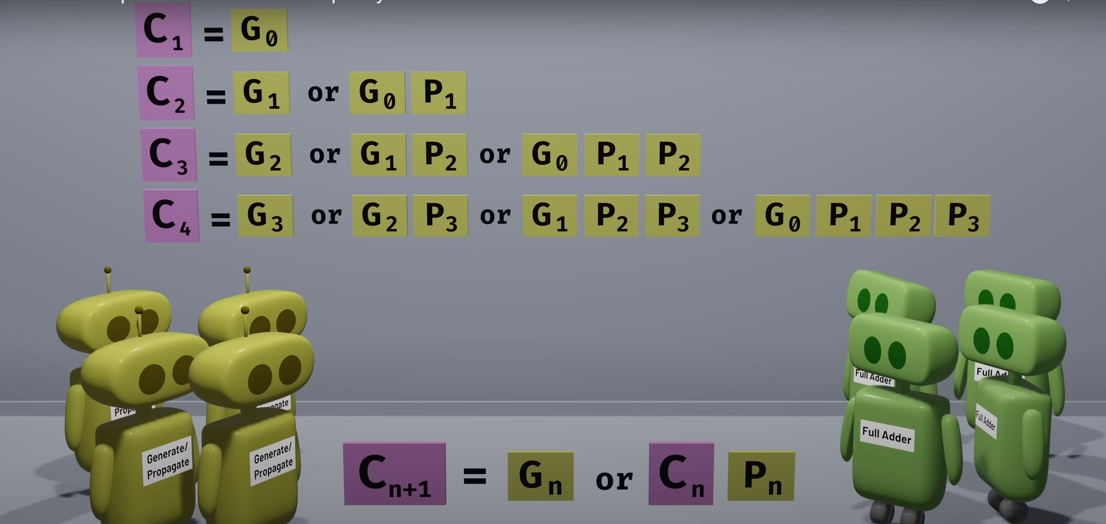

Slide 3
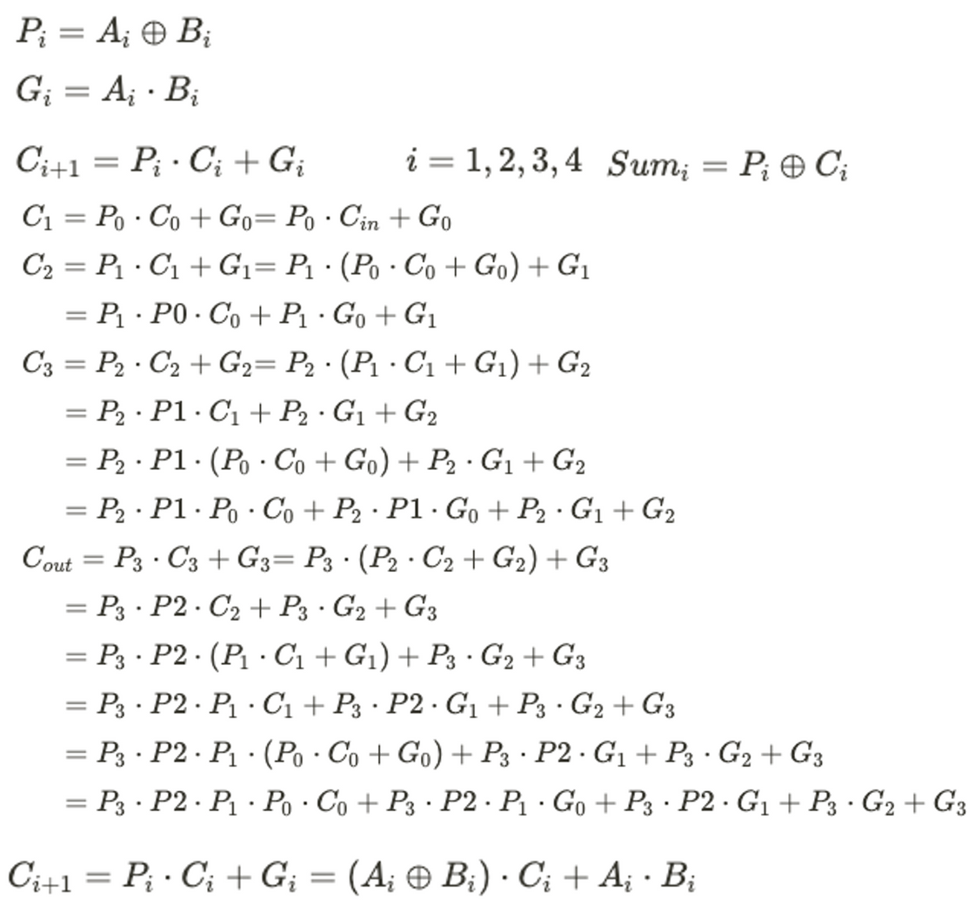

Slide 4
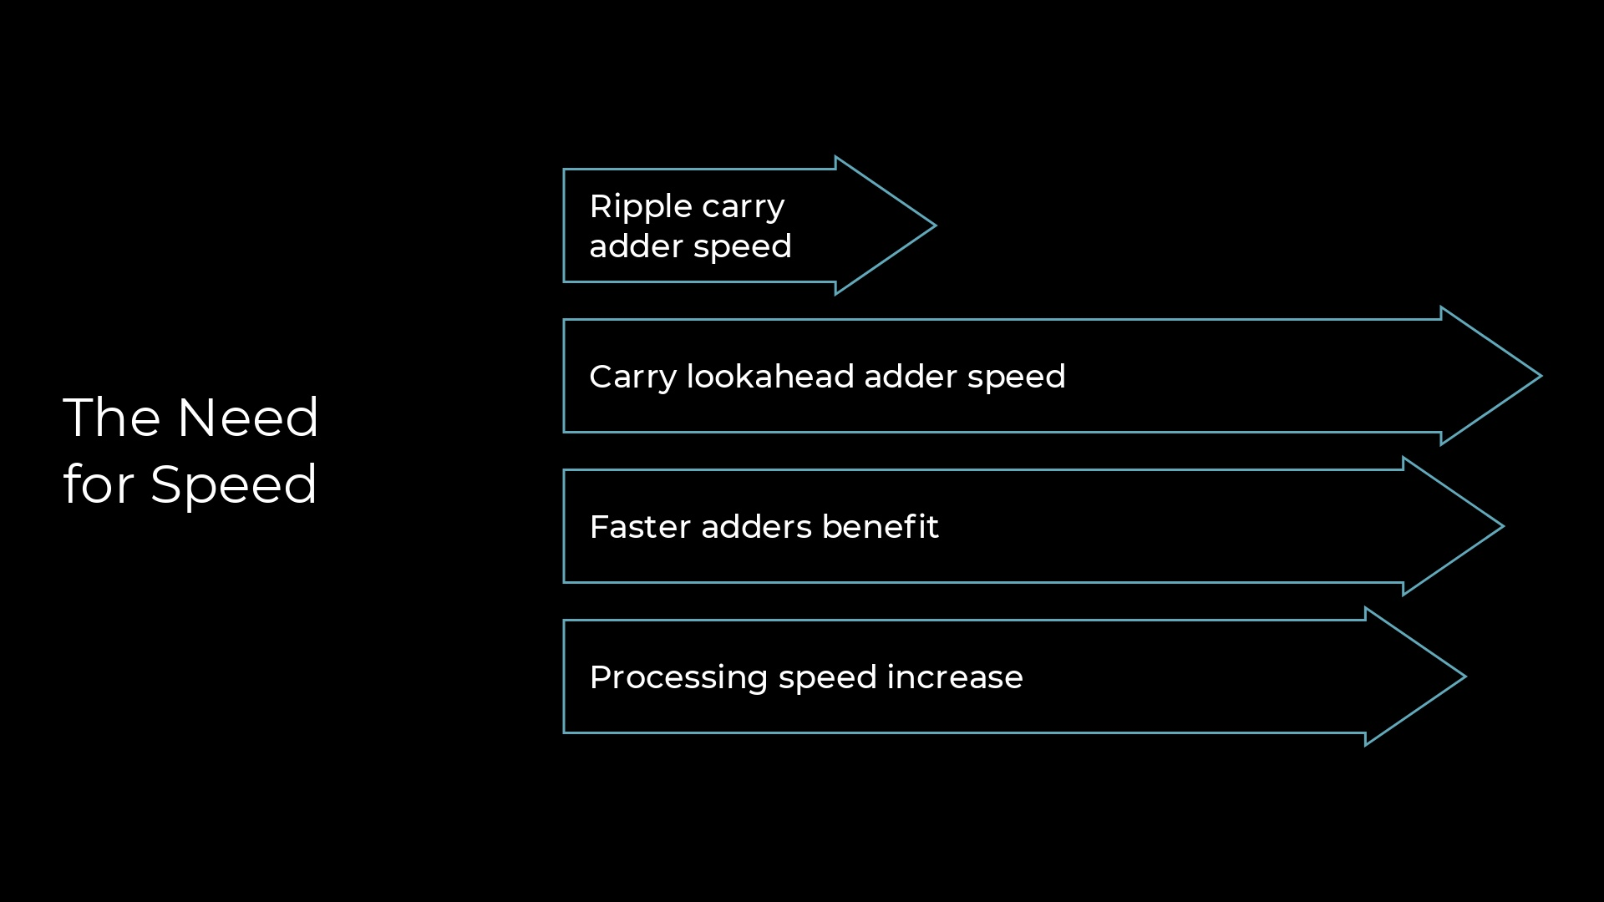

Slide 5
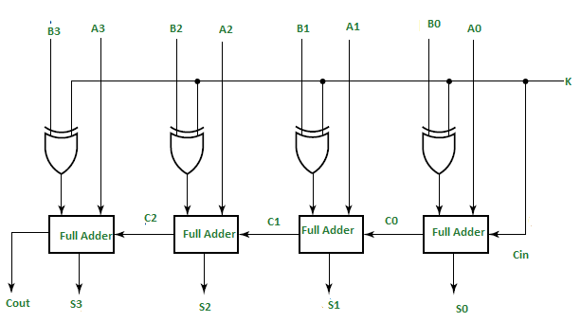
geeksforgeeks.com

Slide 6
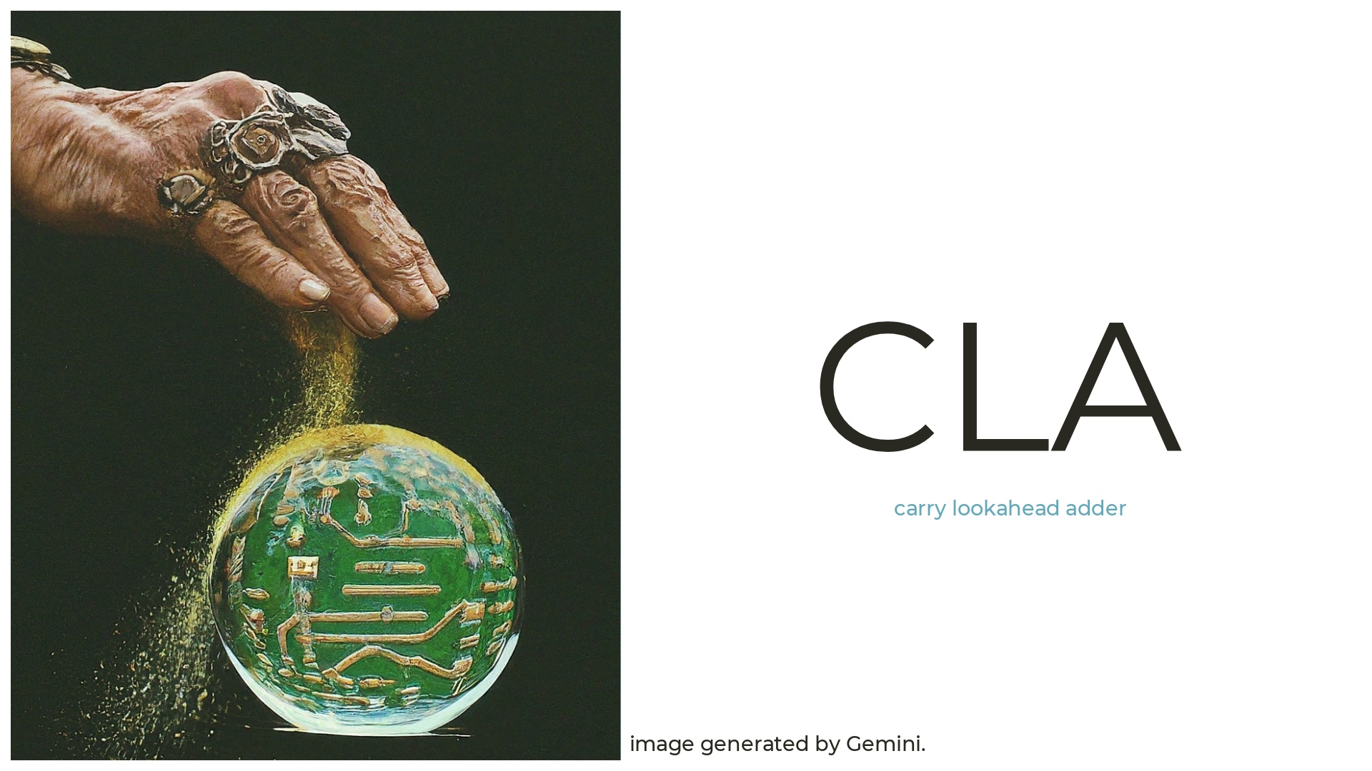

Slide 7
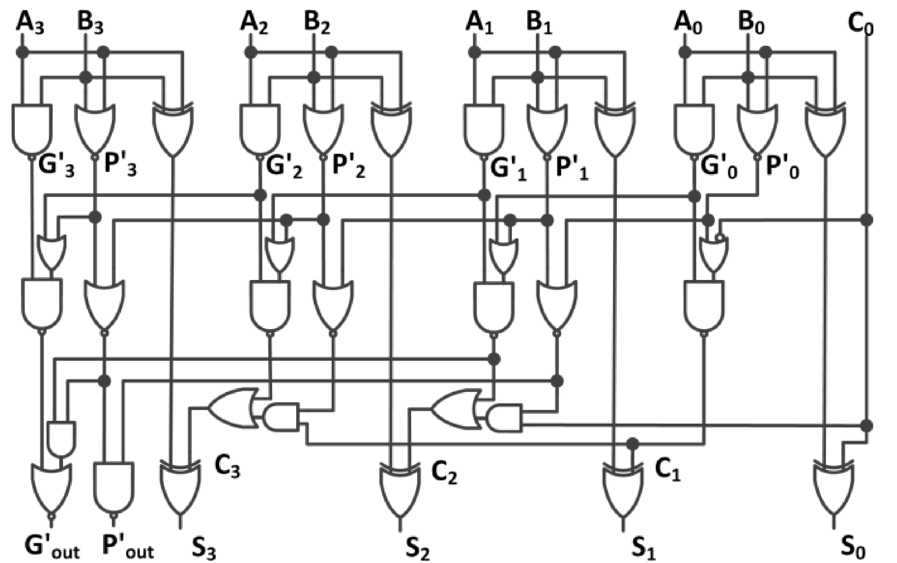
https://ieeexplore.ieee.org/stamp/stamp.jsp?tp=&arnumber=8126457

Slide 8
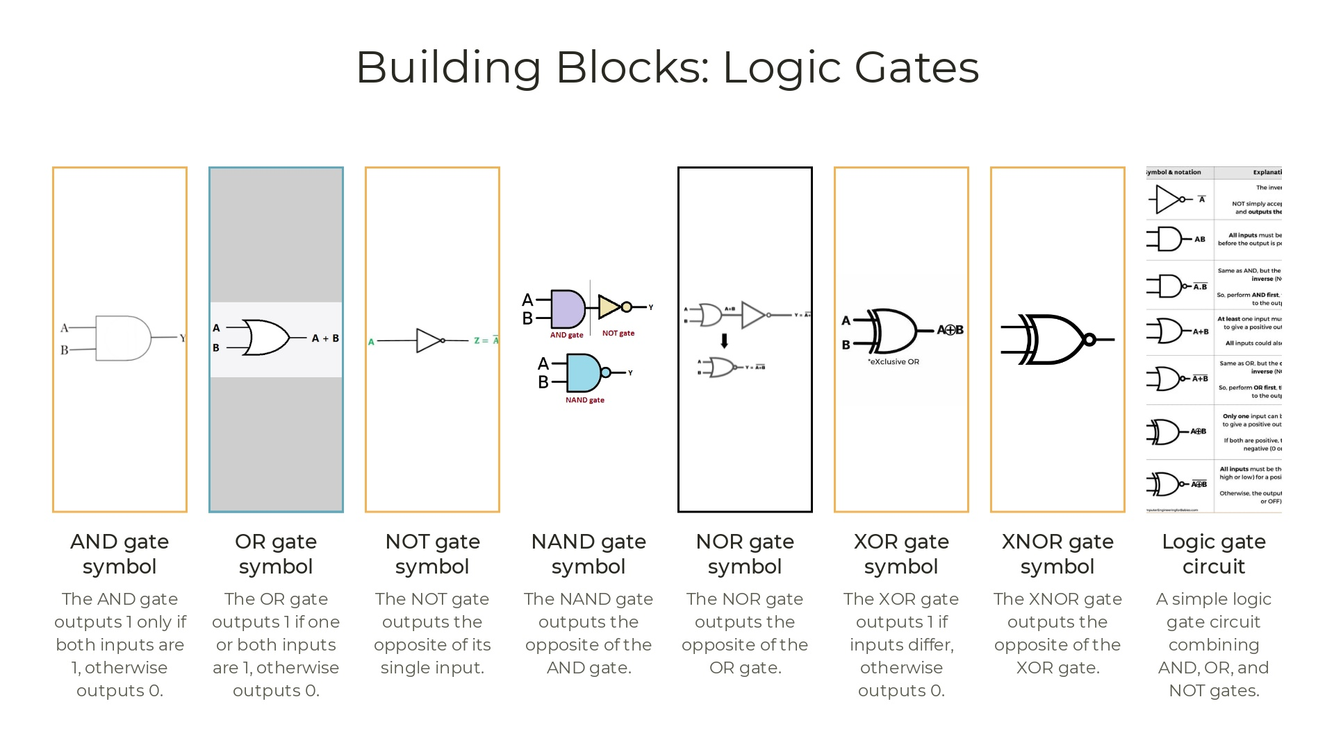

Slide 9


Slide 10
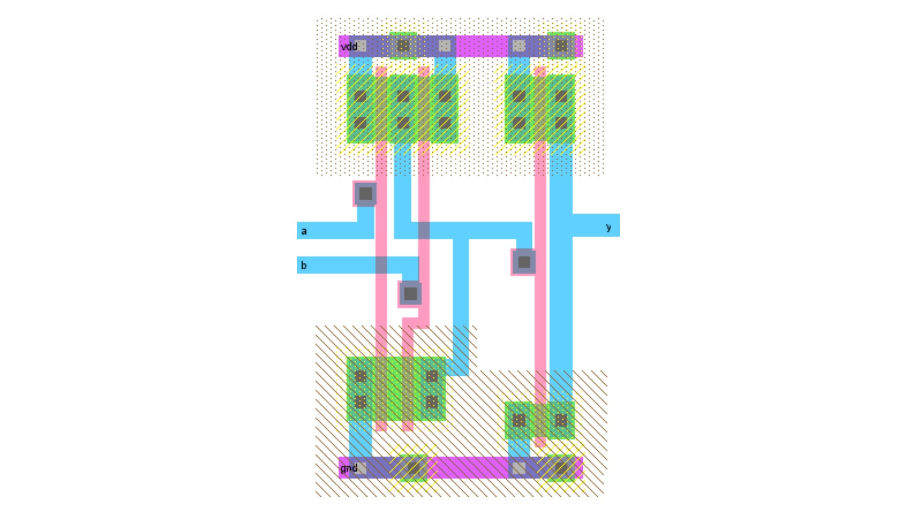

Slide 11
Total Chip Area
A = 4,040,400 * (.180 µm)^2
A = 130,908.96 sq. µm
Total Transistor Count Gates
𝑇_𝑖𝑛𝑣=2
𝑇_𝑛𝑎𝑛𝑑=4
𝑇_𝑥𝑜𝑟=12
LCU Modules
𝑇_𝐶1=2(4)+2=10
𝑇_𝐶2=4(4)+2(2)=20
𝑇_𝐶3=6(4)+3(2)=30
𝑇_𝑃𝐺4=8+2=10
4-bit CLA
𝑇_(𝐶𝐿𝐴−4)=4(30)+10+20+2(30)+10
𝑇_(𝐶𝐿𝐴−4)=220

Slide 12
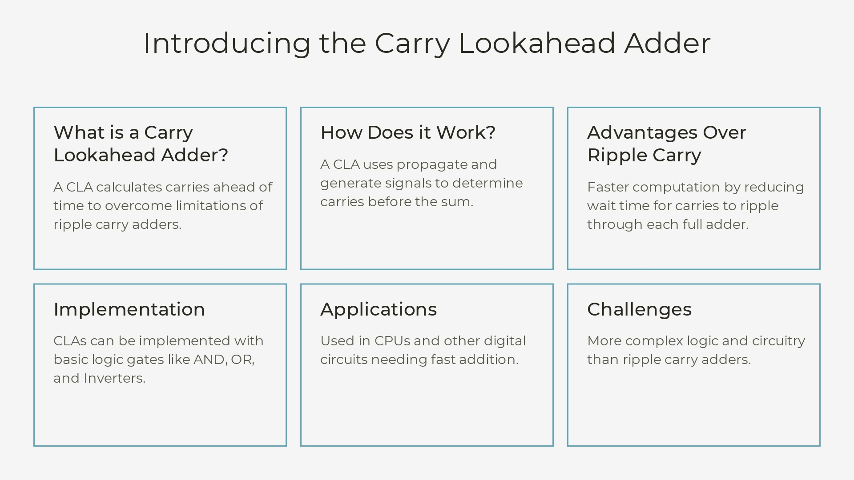

Slide 13
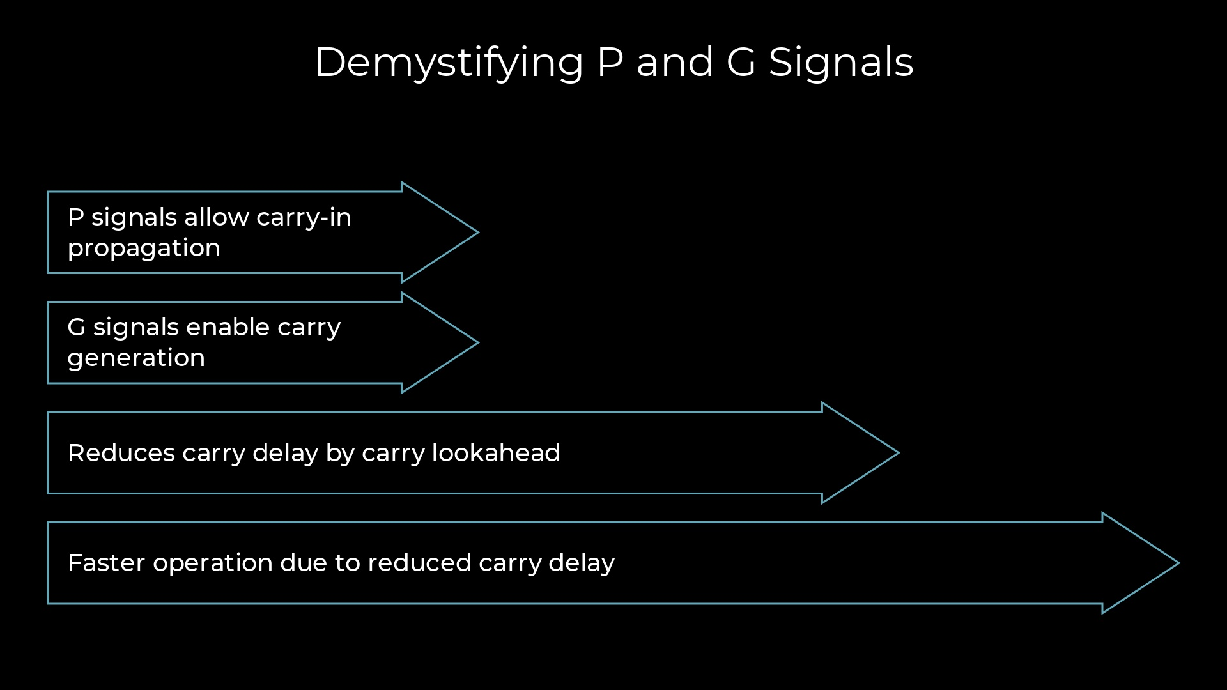

Slide 14
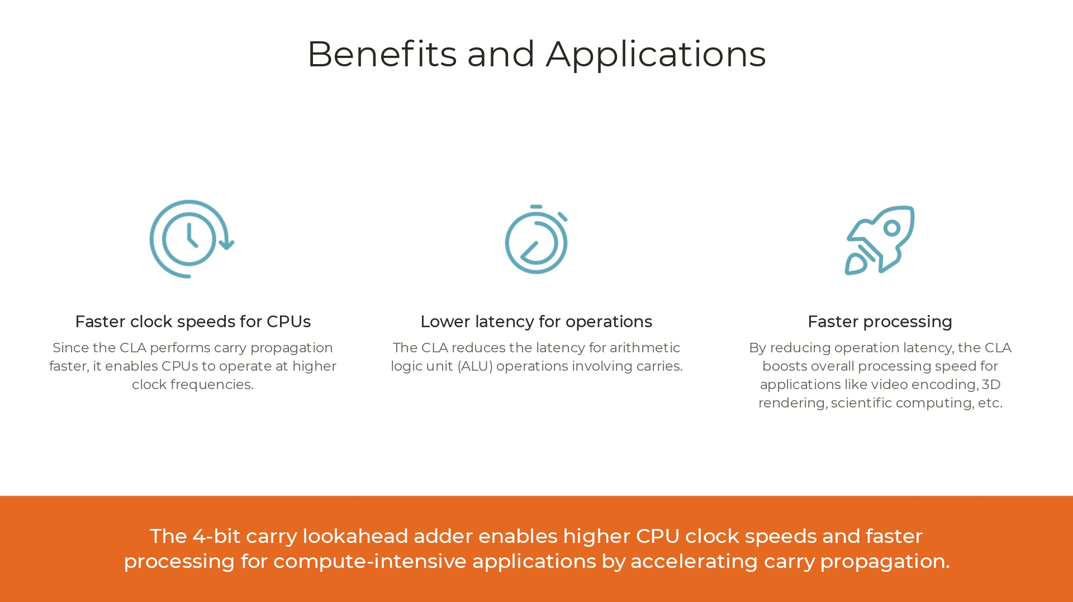

Slide 15
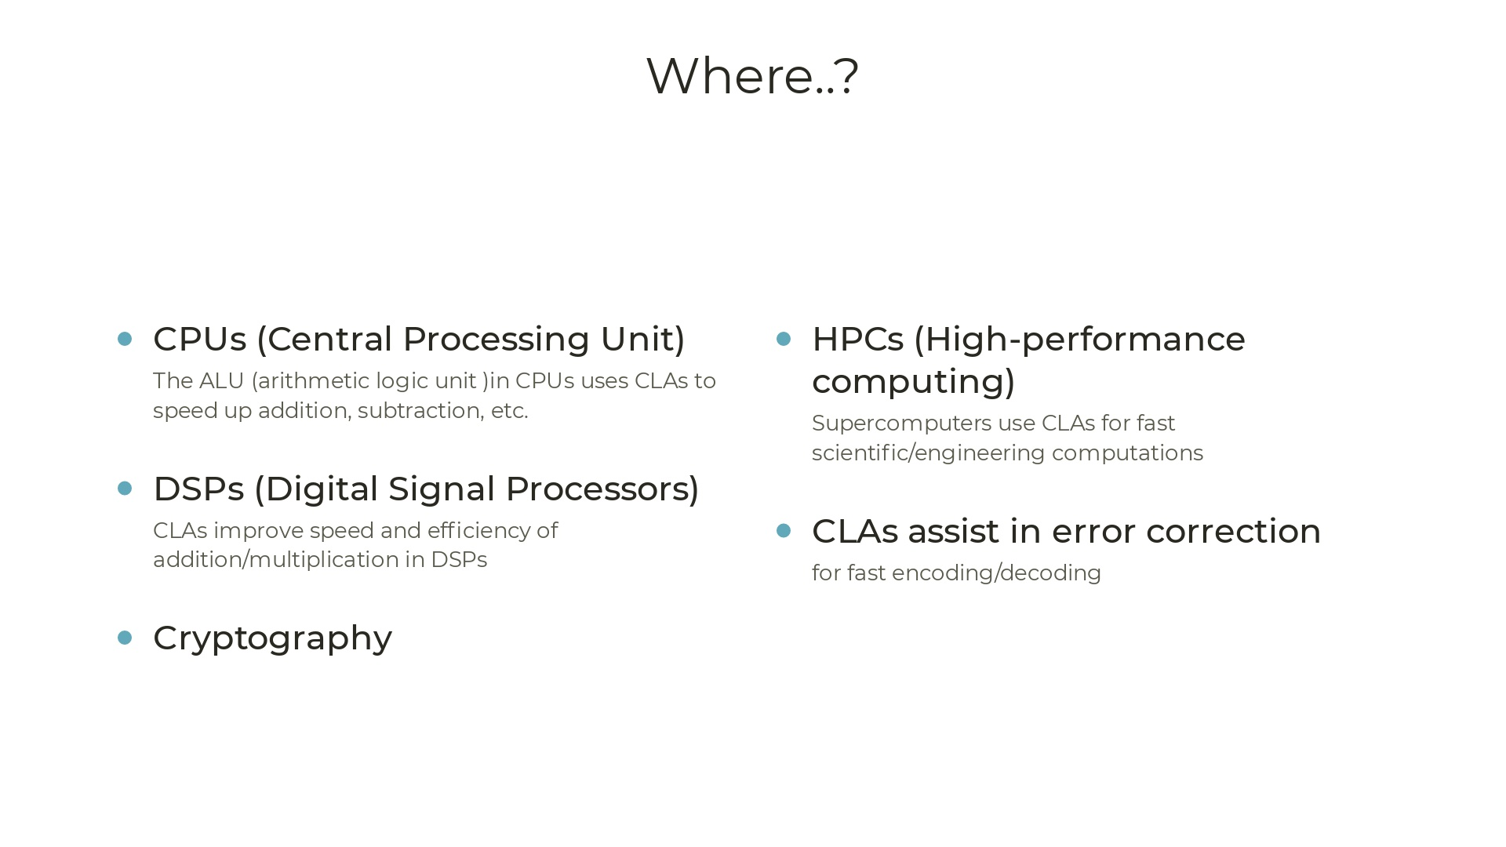

Slide 16
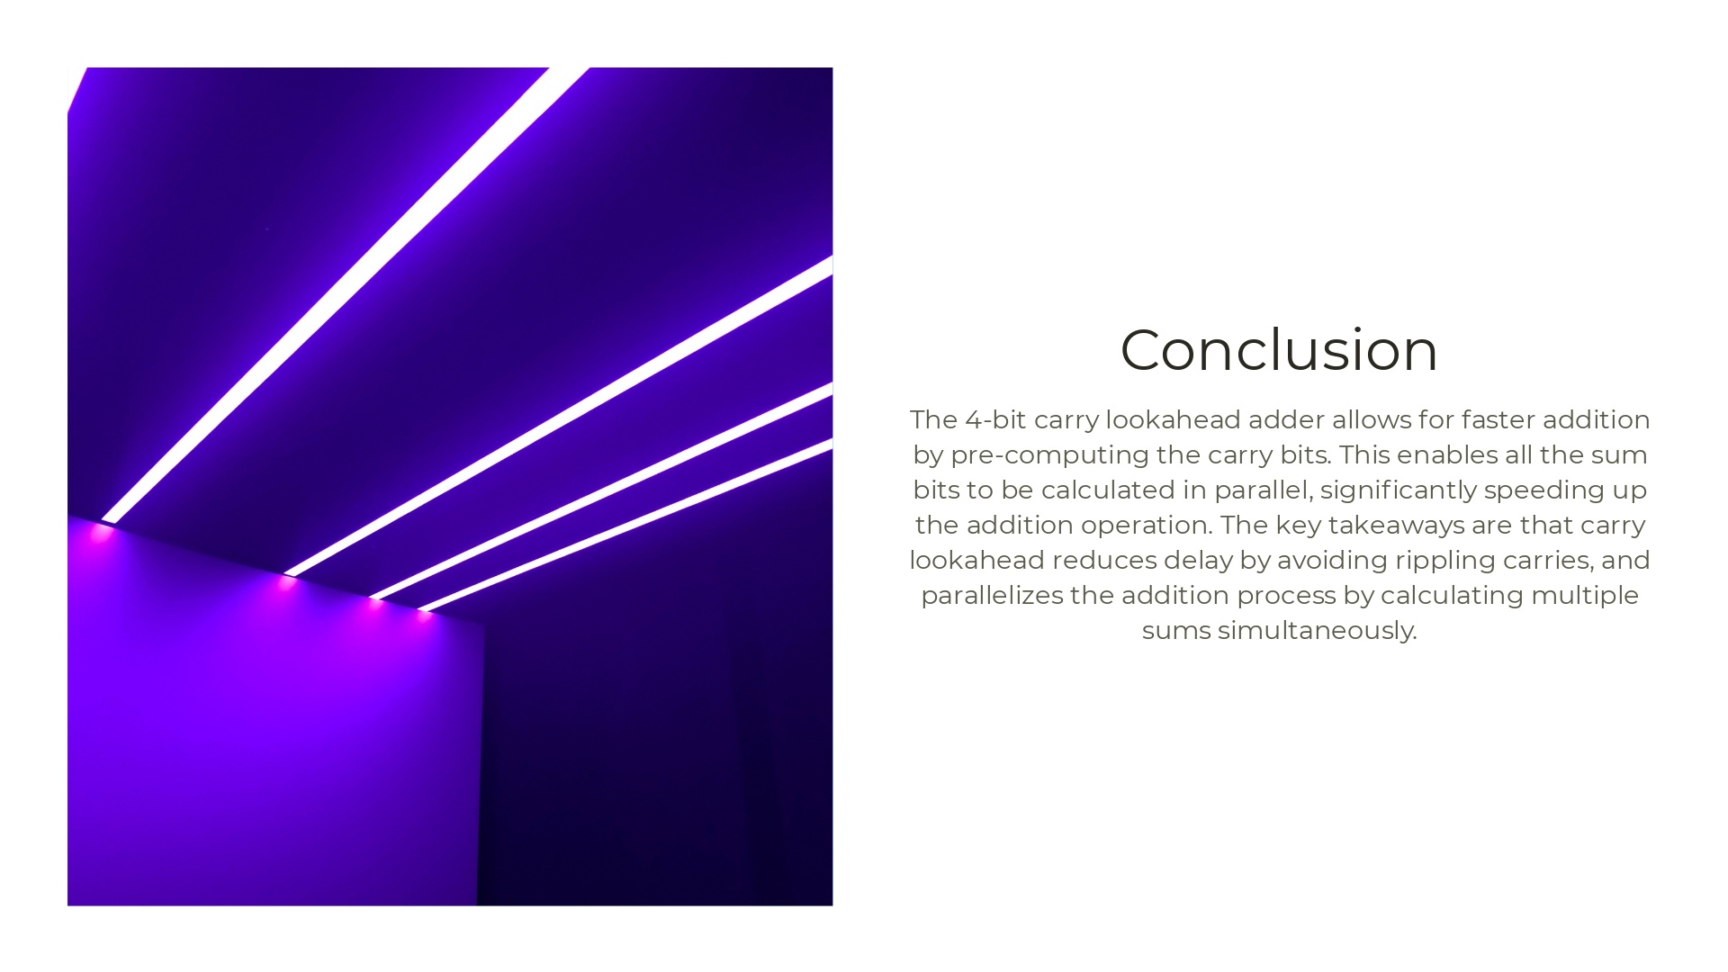

Slide 17
References
J. Miao and S. Li, "A novel implementation of 4-bit carry look-ahead adder," 2017 International Conference on Electron Devices and Solid-State Circuits (EDSSC), Hsinchu, Taiwan, 2017, pp. 1-2, doi: 10.1109/EDSSC.2017.8126457.
https://github.com/jitendrasb24/Carry_Lookahead_Adder (Access Date: Apr 15, 24.)

Slide 18


